Slide 1
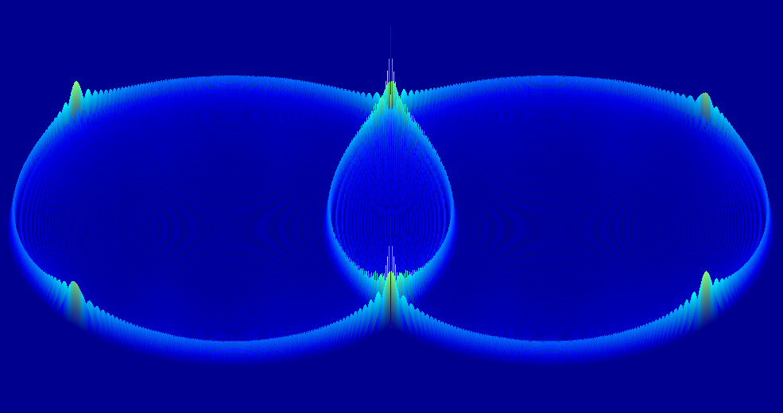

Keep Marching
An overview of time-domain numerical methods for acoustic modelling
Simon Durbridge
Dept. Engineering, Computation & Mathematics
University of Derby
Derby
UK
Notes:
Welcome to my talk about sparse acoustic finite difference time domain
Next: what is acoustic modelling for?

Slide 2
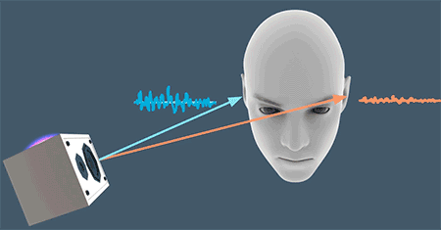
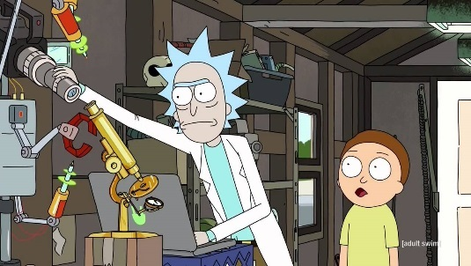
Acoustic Modelling
Purpose
Investigative Modelling
Loudspeakers Systems
Transducers
Acoustical Simulation
Auralization
In this context we are interested in the acoustic response of the system. Therefore the solution is either:
Direct: Sound pressure at a point in space at a point in time
Indirect: The impulse response of the system at a point in the space [do a search for convolution reverb]
[1-3,7-9]
Notes:
What Model?
What Methods?
Ray Tracing
You need lots of rays in large spaces.

Slide 3
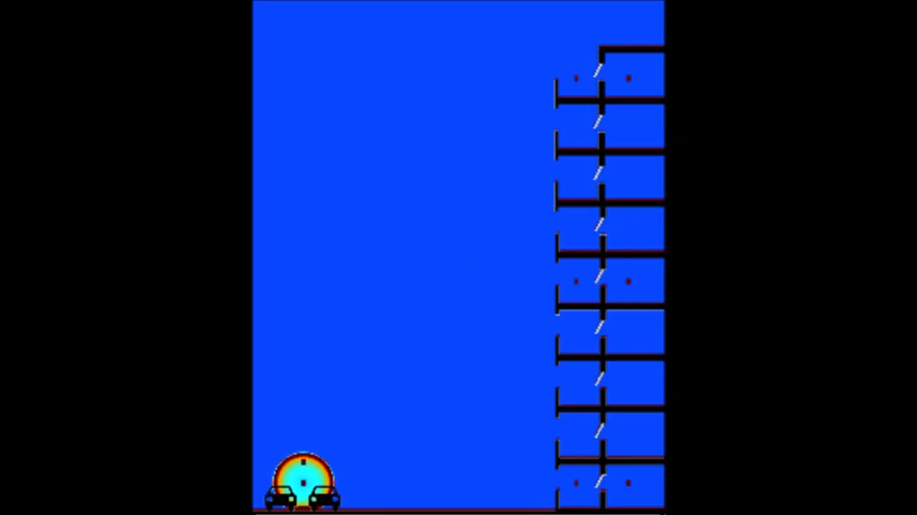
Finite Difference Time Domain Method
[6]

Slide 4
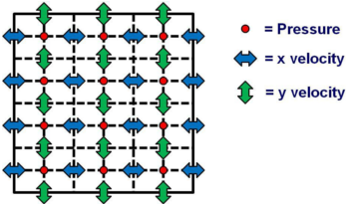





Finite-Difference Time Domain
$$u_{x+\frac{∆x}{2},y}^{x}\left(t+\frac{∆t}{2}\right)=u_{x+\frac{∆x}{2},y}^{x}\left(t−\frac{∆t}{2}\right)−\frac{∆t}{ρ∆x}[p_{x+∆x,y}\left(t\right)−p_{x,y}\left(t\right)]$$
$$u_{x,y+\frac{∆y}{2}}^{y}\left(t+\frac{∆t}{2}\right)=u_{x,y+\frac{∆y}{2}}^{y}\left(t−\frac{∆t}{2}\right)−\frac{∆t}{ρ∆y}[p_{x,y+∆y}\left(t\right)−p_{x,y}\left(t\right)]$$
Update Velocities
Update Pressures
Insert Source
Check Parameters
Display Data
$P_{x,y}\left(t+∆t\right)=P_{x,y}−\frac{c^{2}ρ∆t}{∆x} [u_{x+∆x}\left(t+\frac{∆t}{2}\right)−u_{x−∆x}\left(t+\frac{∆t}{2}\right)]$ $−\frac{c^{2}ρ∆t}{∆y} [u_{y+∆y}\left(t+\frac{∆t}{2}\right)−u_{y−∆y}\left(t+\frac{∆t}{2}\right)]$
+$\frac{∆t}{2}$
+$\frac{∆t}{2}$
2nd order in space
1st order in time
[4-8]
Notes:
FDTD works this way, the math example is 2 dimensions, the graphical example is 2 dimensions.

Slide 5
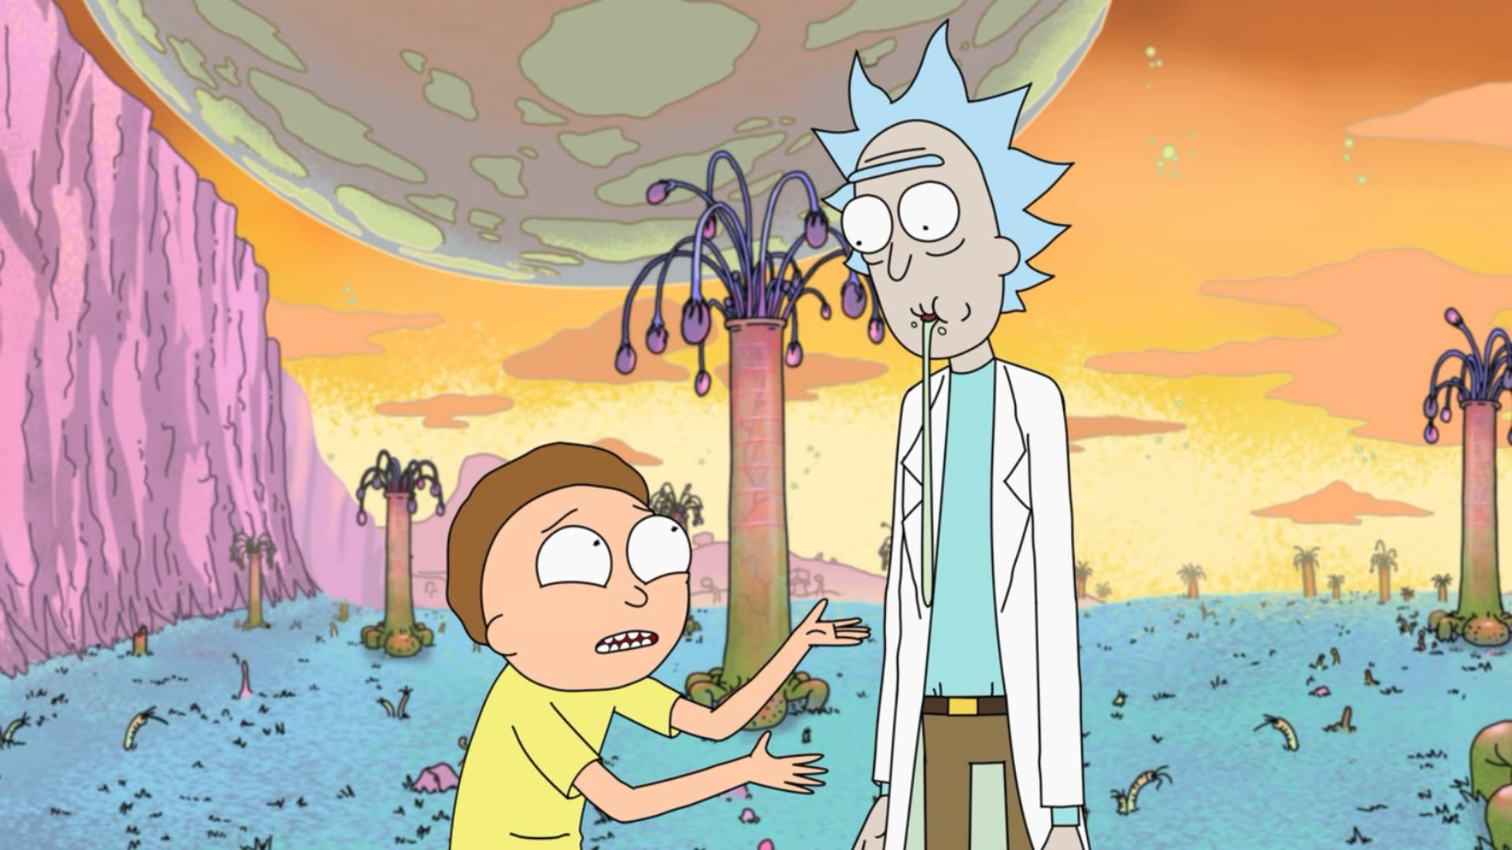
BENEFITS & DRAWBACKS
BENEFITS
DRAWBACKS
Simple ‘stencil’ for scaling across the problem space
Can give direct solution
Can have greater or lesser problem complexity
Inherent low frequency behaviour
Scalable kernel for different problem definitions
Requires a vast amount of memory interaction
Requires about 10 degrees of freedom per wavelength to be stable enough
Large space simulation requires long solving times i.e. for a longer amount of time as well as the solution taking long to get
[2-7]
Notes:
Method requires full discretization of the domain
Fine grid spacing required for high frequency modelling
Higher Order Schemes required to minimize numerical dispersion
Very difficult to implement non-rectilinear grids
Solving takes a very long time for large problems
even if parallelised

Slide 6
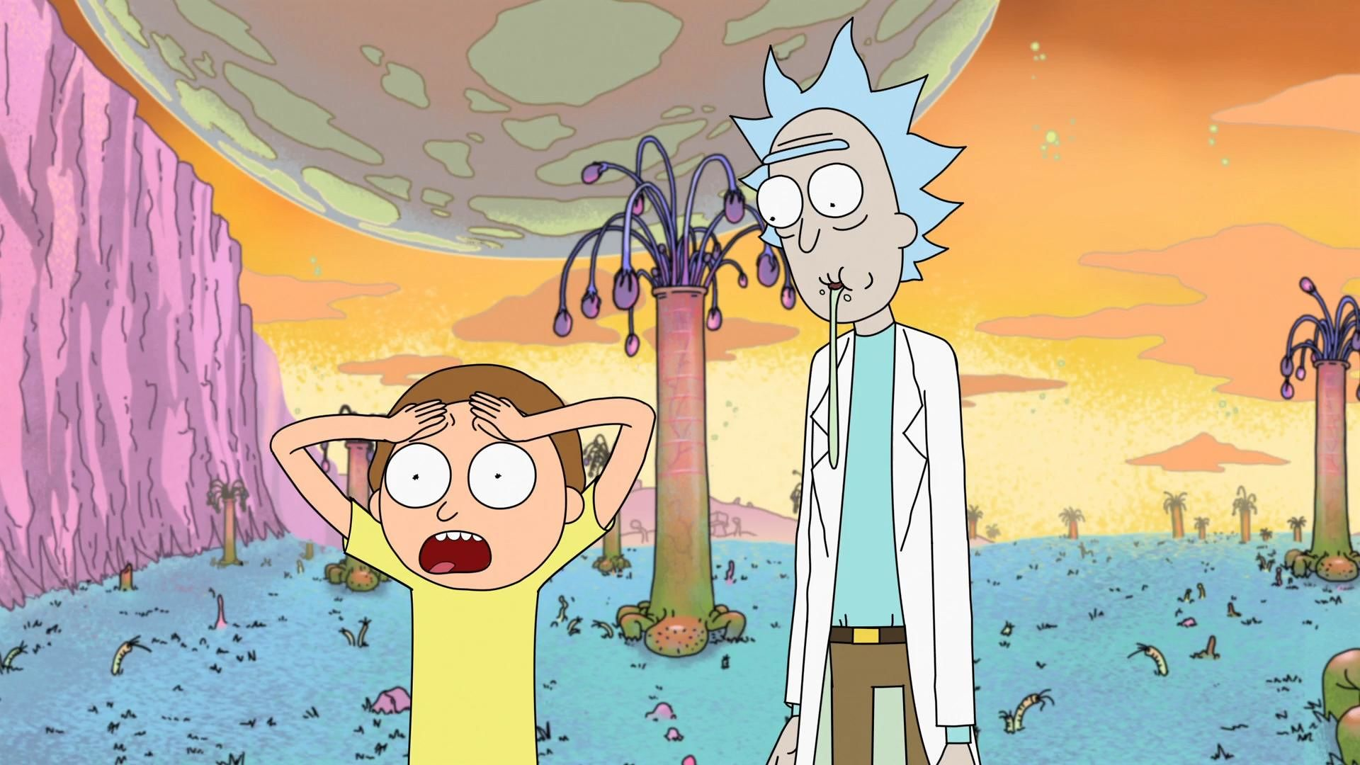
ALL IS NOT LOST
There are potential methods for improving upon the standard FDTD scheme!
Two of these are:
Pseudospectral time domain (PSTD)
Sparse-Finite difference time domain(SFDTD)
[2,4]
Notes:
You can do spectral fdtd solving using fft
You can parallel up on a gpgpu
You can hybridize

Slide 7
ALL IS NOT LOST
There are potential methods for improving upon the standard FDTD scheme!
Two of these are:
Pseudospectral time domain (PSTD)
Sparse-Finite difference time domain(SFDTD)
[2,4]
Notes:
You can do spectral fdtd solving using fft
You can parallel up on a gpgpu
You can hybridize

Slide 8
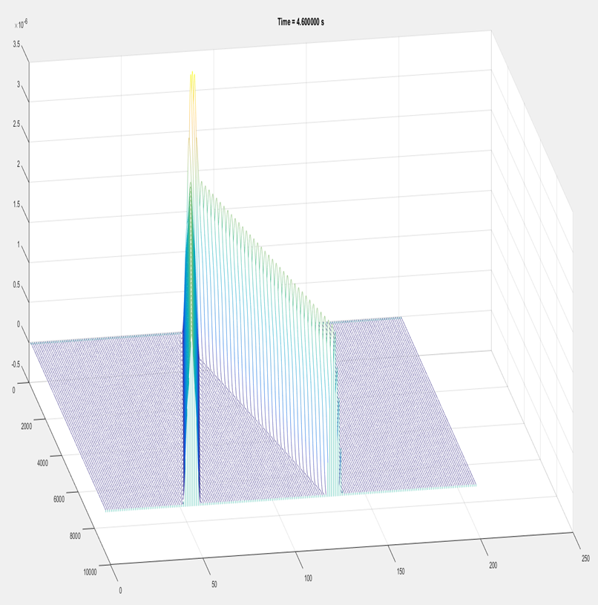
PSTD method
Differentiate for 1 dimension of the problem all at once
Accuracy of order Nlog2N
Inherently parallelizable on GPGPU
May benefit from derivation of an Implicit scheme to reduce memory access
Can provide direct solutions or indirect solutions
[4]

Slide 9
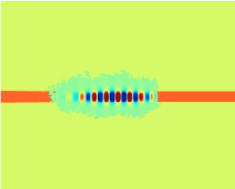
Sparse FDTD
Active energy dynamic windowing
Maintains very simple and scalable stencil
Adds an extra step to the computation
Could provide direct or indirect soultions
[5]

Slide 10

Conclusion
There are potential methods for improving upon the standard FDTD scheme, including PSTD & SFDTD
Both methods are explicit, and may benefit from an implicit form for low memory consumption
Experimental data is required to confirm which method is faster at solving
Only PSTD has been implemented in acoustics for real time solving, but can be used to solve up to medium frequencies in real time on the GPGPU
SFDTD has not been implemented in acoustics as of yet according to literature
[1 - 9]
Notes:
You can do spectral fdtd solving using fft
You can parallel up on a gpgpu
You can hybridize

Slide 11
Questions?
Simon Durbridge
Dept. Electronics, Computing & Mathematics
University of Derby
Derby
UK

Slide 12

1. Elorza DO (2005) Room acoustics modeling using the ray- tracing method : implementation and evaluation. University of Turku
Mourik J Van, Murphy D (2013) Geometric and wave-based acoustic modelling using Blender. AES 49th Int Conf Audio Games 1–9.
3. Hill AJ (2012) Analysis , Modeling and Wide-Area Spatiotemporal Control of Low-Frequency Sound Reproduction.
4. Angus JAS, Caunce A (2010) A GPGPU Approach to Improved Acoustic Finite Difference Time Domain Calculations. 128th Audio Eng. Soc. Conv.
Doerr C (2013) Sparse Finite Difference Time Domain Method. IEEE Photonics Technol Lett 25:1–1. doi: 10.1109/LPT.2013.2285181
Jones C FDTD - Road Noise into Apartments with Balconies (Section View) - YouTube. https://www.youtube.com/watch?v=2YMDHTn-j7c. Accessed 24 Oct 2016
Durbridge S (2016) Improvements in Acoustic Modelling for Analysis & Auralization. Derby
Durbridge D (2016) S-FDTD for acoustic modelling, Derby
Google (Octover 2016), Spatial Audio for Virtual Reality, https://developers.google.com/vr/concepts/spatial-audio, Accessed 30-11-2016
IMAGES
http://www-users.york.ac.uk/~so523/WASPAA_Results.html/
https://i.ytimg.com/vi/eOBoKxEcVAA/maxresdefault.jpg
http://ease.afmg.eu/index.php/reflection-pattern-studies-with-ray-tracing.html
http://www.adamjhill.com/
http://www.cinemablend.com/television/Rick-Morty-Season-3-Premiere-Way-Sooner-Than-Expected-123037.html
https://i.ytimg.com/vi/eOBoKxEcVAA/maxresdefault.jpg
http://cdn.breathecast.com/data/images/full/33863/master-rick-and-morty.jpg
http://www.vulture.com/2015/09/rick-and-morty-universe-comprehensive-list.html
Notes:
References

